Slide 1
Dunoon Overhead Line Rebuild Project
Community Liaison Group Kick-off Meeting
29 September 6-7:30pm

Slide 2
Safety Moment!
SSEN Transmission make safety their number one priority on all projects.

Slide 3

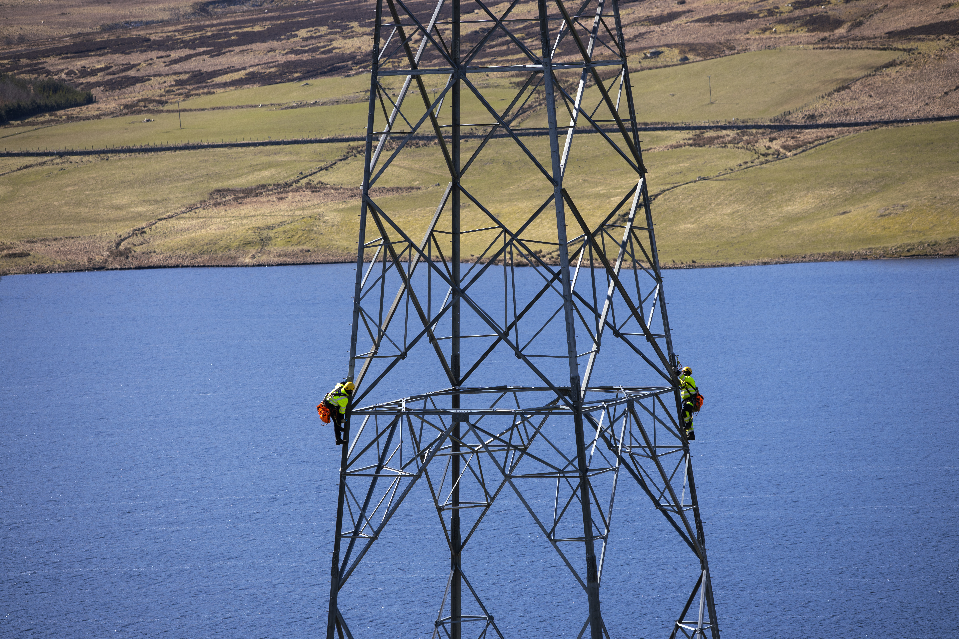

Agenda
  Introductions
  About SSEN Transmission
  Terms of Reference
  Appointment of Facilitator
  Project Overview
  Forestry works
  Principal Contractor Works
  Community Queries
  AOB
  Next Meeting

Slide 4
Introductions
SSEN
TRANSMISSION
OMEXOM (PRINCIPAL CONTRACTOR)
SCOTTISH WOODLANDS
Paul Fergson
Project Manager
Julie Larkin
Project Manager
Andrew Cooper Forestry Manager
Martha Smart
Community Liaison Manager
Martha.E.Smart@sse.com
07880998846
Lewis Kane
Project Engineer
Key Contact:
4

Slide 5
About SSEN Transmission
We are SSEN Transmission, the trading name for Scottish Hydro Electric Transmission.
We are responsible for the electricity transmission network in the north of Scotland, maintaining and investing in the high voltage 132kV, 220kV, 275kV and 400kV electricity transmission network.
Who we are
We’re part of SSE plc, one of the world’s leading energy
companies with a rich heritage in Scotland that dates
back more than 80 years. We are also closely regulated
by the GB energy regulator Ofgem, who determines how
much revenue we are allowed to earn for constructing,
maintaining and renovating our transmission network.
What we do
We move electricity all over the UK. We manage the
electricity network across over a quarter of the UK’s land
mass, crossing some of the country’s most challenging
terrain. We connect renewable energy sources to our
network in the north of Scotland and then transport it to
where it needs to be. From underground subsea cables
and overhead lines to electricity substations, our network
keeps your lights on all year round.

Slide 6
Terms of Reference
The Community Liaison Group (CLG)
Voluntary forum for constructive discussion, has no statutory powers
Brings together the community, SSEN Transmission and contractors
Provides project updates, considers local views and capitalise on opportunities
Our Aim
Support meaningful community engagement
Share updates on construction stages and activities
Provide a forum to raise concerns, ask questions and give feedback
Discuss how local issues are being addressed
Meetings
Held quarterly, with additional meetings if required
In-person, online or hybrid format
Agendas issued in advance
Attendees confirmed in advance via CLM
Code of Conduct
Open, constructive and respectful discussion
All views and differences to be treated with consideration
Inappropriate behaviour may result in removal or the meeting ending
Recording requests must be agreed in advance
The Group Set-up
Facilitator selected by members at the first meeting
Membership includes SSEN Transmission, contractors and local representatives, inc elected members, residents, businesses and interest groups
Membership may be reviewed to keep discussions focused, SSENT will ensure the correct project reps are present
Communications
Meeting information, agendas and minutes shared by email by CLM
Draft minutes issued for approval, within one week
Agreed minutes published on the project webpage
SSEN Transmission can attend Community Council meetings when requested

Slide 7
Appointment of Facilitator
Key responsibilities:
Lead the meeting, keep time, ensure code of conduct is maintained, make sure everyone's needs are met
Proposal:
CLM or Community Council Rep

Slide 8
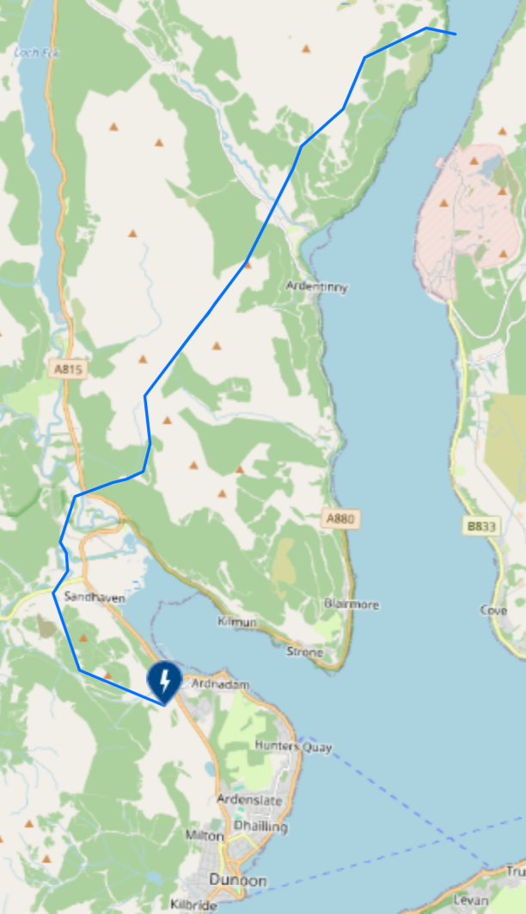
Dunoon Overhead Line Rebuild Project
Received consent from Scottish ministers in Oct 25 to replace the existing overhead line connecting Dunoon to the wider national grid. The project will enhance local network resilience and renew ageing infrastructure- some dating from the 1970s- helping to future-proof the transmission network in Argyll and Bute.
The main project elements are as follows:
Installation and operation of approx 18km of replacement double-circuit overhead line between Dunoon substation and west of where the overhead line crosses Loch Long. This includes installing 77 new steel towers varying between 23m and 39m tall, at spans of around 230m on average
Reconductoring of the Loch Long crossing
Decommissioning/removal of the existing 132kV OHL
Associated tie in works at Dunoon substation

Slide 9
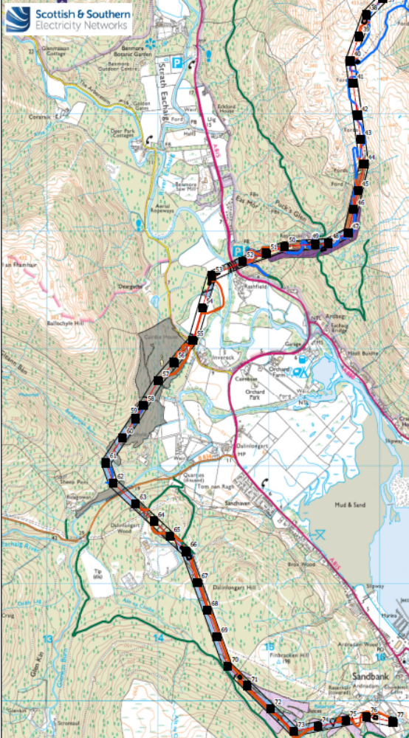
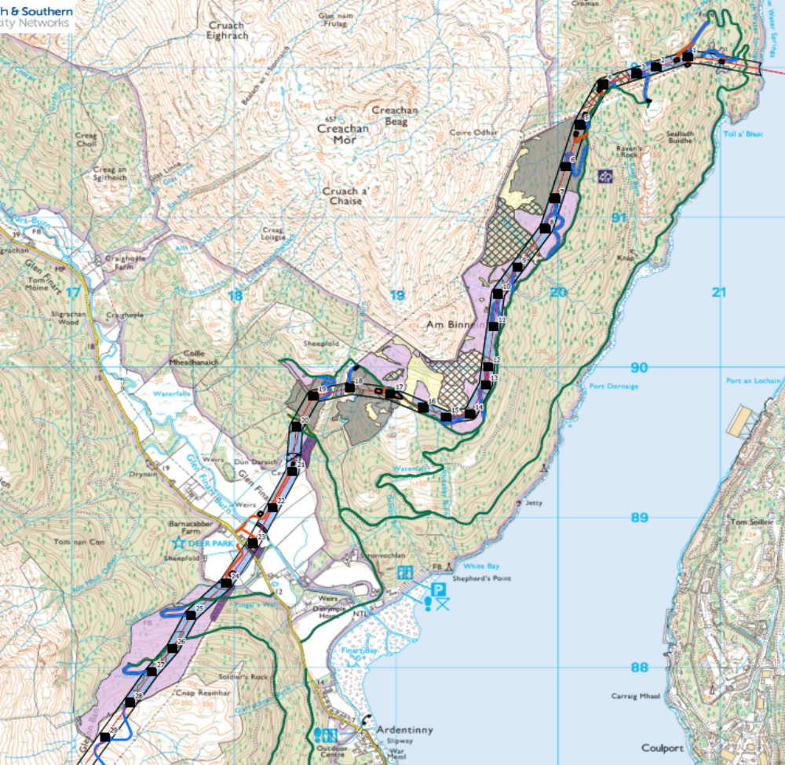
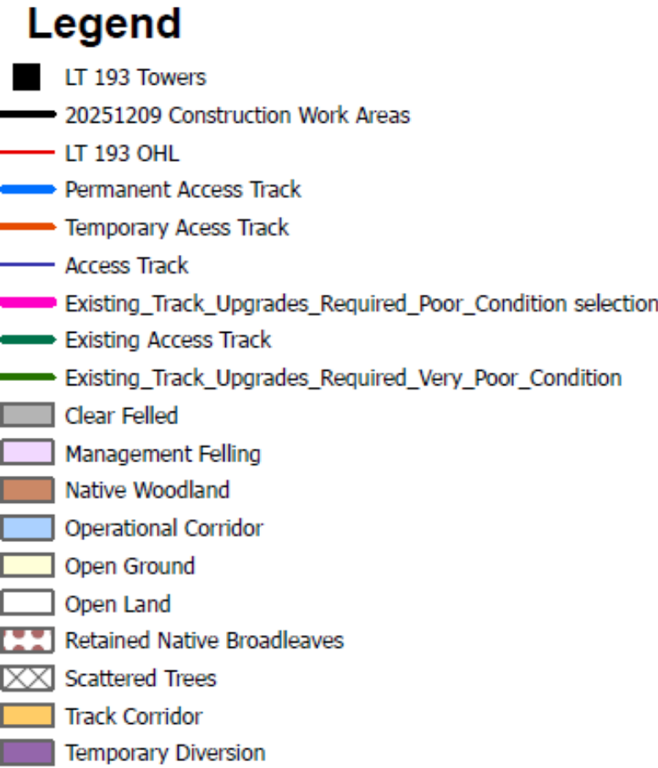
Forestry Works
Undertaken by Scottish Woodlands
Started Aug 26 expected to continue until Q4 27

Slide 10
OVERVIEW OF ACCESS TRACK WORKS TO DATE
Timeline

Slide 11
OVERVIEW OF WORKS TO DATE
2026
TIMELINE
TIMELINE
02.03.2026
Public Road Improvement WORKS
13.07.26
EXISTING TRACK UPGRADES
NEW ACCESS TRACK INSTALLATION
31.08.26
26.03.26
11.05.26
19.10.26
GAIRLETTER SITE SETUP
SANDBANK SITE SETUP
LOCH LONG CROSSING FOUNDATI0N UPGRADES
Notes:
Staged start – focus on preparatory works prior to full mobilisation.
Programme led by tree cutting & restricted by winter working

Slide 12
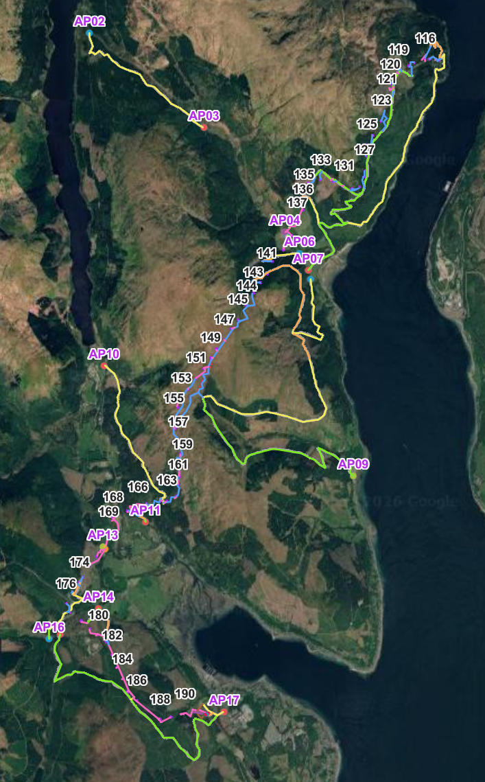
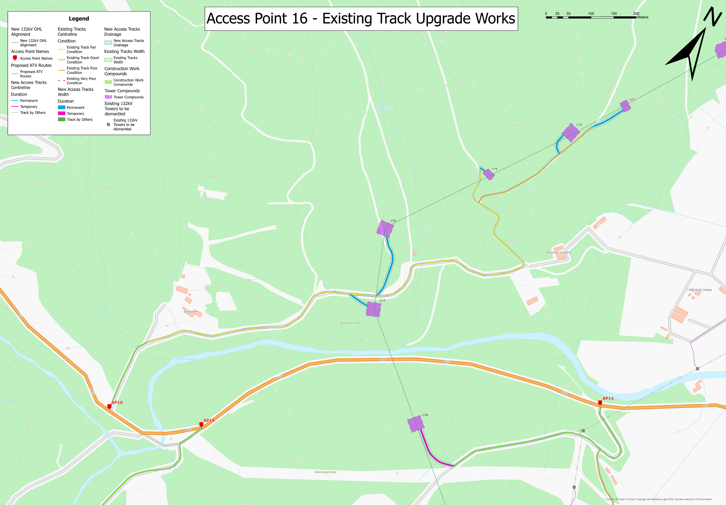
Overview of Existing Track Upgrades
Approximately 1 mile of existing track upgraded
Benefits include:
Improved safety for construction, forestry and maintenance vehicles
Better pedestrian safety for walkers, off-road cyclists and trail runners and other recreational users
Improved resilience of local infrastructure
Reduced need for frequent maintenance interventions and associated vehicle movements.
Renewal of existing track to prepare for new tracks and tower locations through AP16
Passings places also upgraded with new places added to aid in vehicle flow through the route
Existing track in poor condition upgraded
Existing track in fair condition upgraded
Existing track in good condition upgraded
Notes:
Located along the B836 from the Holy Loch, these proposed track upgrades will improve vehicle and pedestrian safety, enhance accessibility for recreational users, reduce ongoing maintenance requirements, improve drainage and environmental performance, increase the resilience and reliability of access during adverse weather conditions, and provide a smoother, more sustainable route for both operational and public use.

Slide 13
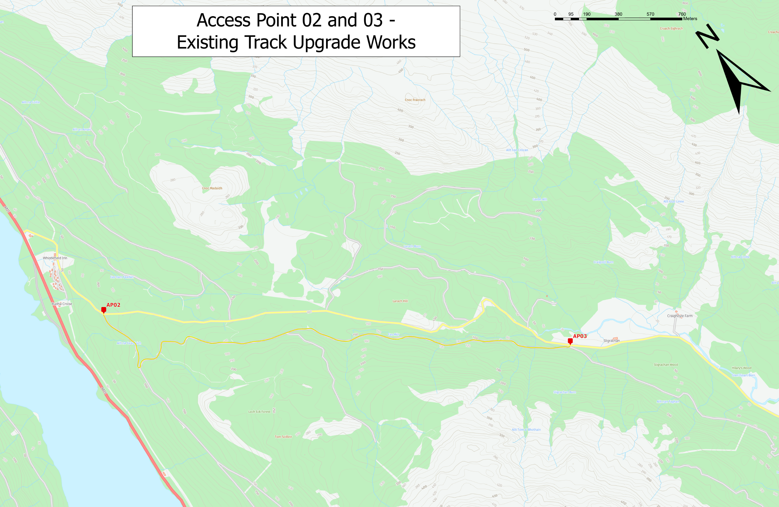
Overview of Existing Track Upgrades
Approximately 2 miles of existing track upgraded
Benefits include:
Removal of construction traffic during the works from Ardentinny Road between AP02 and AP03
Passings places also upgraded with new places added to aid in vehicle flow through the route
Safer route of travel for construction traffic
Also provides a more consistent and stable running surface for other stakeholders
Existing track in fair condition upgraded
Notes:
Similar to AP16, these proposed track upgrades will improve the condition of the existing route, providing safer and more reliable access for vehicles, walkers and other users while reducing future maintenance requirements. Main focus of these upgrades is to remove construction traffic from approx. 50% of Ardentinny road.

Slide 14
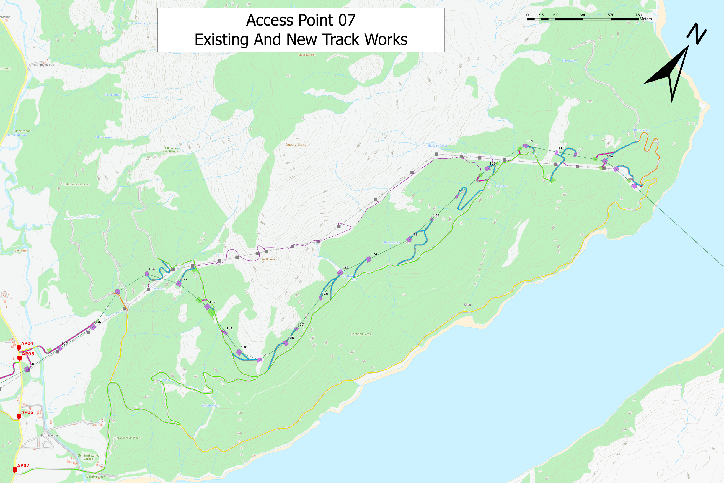
Overview of Existing Track Upgrades
Approximately 5km of track upgrades currently ongoing
New tracks and compounds being constructed at top of track
3 new working platforms and approx. 600m of new track being constructed
Passings places also upgraded with new places added to aid in vehicle flow through the route
Located at the west side of Loch Long Crossing
New tracks and compound construction
Upgrade of poor condition tracks
Existing track in good condition in process of upgrade
Existing track in fair condition in process of upgrade
Notes:
These track upgrades and new tracks will facilitate the upgrade of the two existing towers at the western side of the Loch Long Crossing in anticipation of the main works scheduled for next year.

Slide 15
FUTURE WORKS

Slide 16
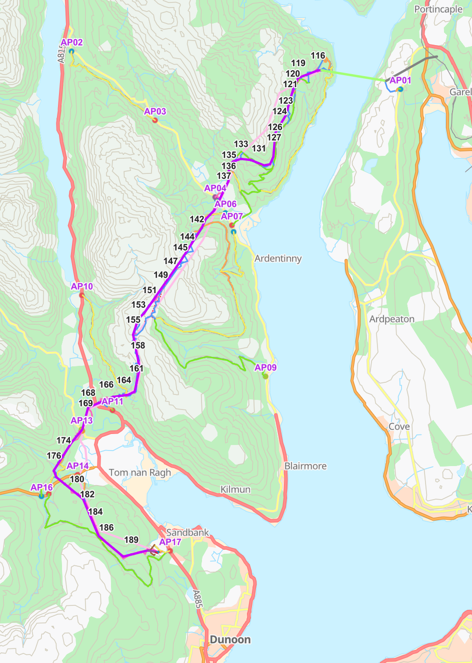
FUTURE WORKS
From now until the end of the year, our work is focused on:
  AP07 (Ardentinny Shore Forestry Track) – Currently ongoing
  AP09 (Gairletter Forestry Track) – To be determined based on FLS felling (likely November)
Majority of programme of works is based on tree cutting programme. When areas of cutting and felling are completed, these become available to Omexom
Majority of new track and compound construction will be progressed in the new year, indicatively from February onwards
Notes:
From September until end of this year, works are mainly constrained to Gairletter and Ardentinny shore track along Loch Long.
Our other works are constrained by the tree cutting programme and following this, seasonal and weather dependencies, we would not be working up on hillsides in winter, mainly flat, stable ground during the winter periods.

Slide 17
OVERVIEW OF FUTURE WORKS
HIGH LEVEL TIMELINE - WINTER BREAKS NOT SHOWN FOR CLARITY
2027
Existing Track Upgrades
New Track & Compound Install (higher altitudes)
New Track & Comp
(lower altitudes)
Foundation Works
Tower Assembly
2028
New Track & Comp (lower altitudes)
New Track & Compound Install
(higher altitudes)
Foundation Works
Tower Assembly
2029
Tower Assembly
Wiring Works
Reinstatement Works
Notes:
2027 – Mainly access and foundation works, leading to tower assembly
2028 – End of access works towards middle of year, foundation works end towards end of year, tower assembly continues
2029 – End of tower assembly end of Spring leading to wiring and ultimately reinstatement works

Slide 18
Thank you !
Any Questions?

Slide 19


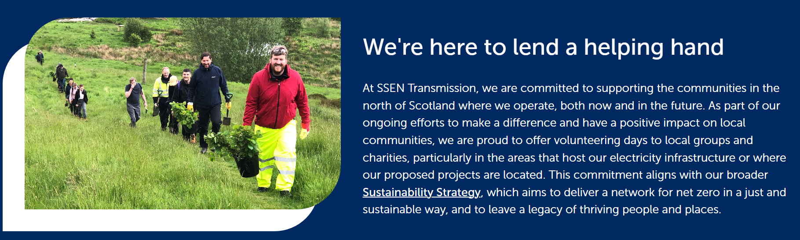

Community Queries

Slide 20

AOB
Key Contact: Community Liaison Manager
Martha Smart

Slide 21
Next Meeting
Date (Tues 12th or 19th of Jan?), time and location to be agreed with group
Agree representatives

