Slide 1

Banniskirk Hub
Community Liaison Group
Wednesday 16 September 2026
Ross Institute, Halkirk

Slide 2
Agenda
Welcome, introductions and apologies Approval of the previous meeting minutes Review of outstanding actions Review of the Terms of Reference Project Update Community issues raised by residents Community Council issues Any other business Date of next meeting

Slide 3
Welcome, introductions & apologies
Name | Role
Martin Godwin | Community Liaison Manager – SSEN Transmission
Connor Kane | Deputy Project Director – SSEN Transmission
Gus McIntosh | Senior Project Manager – SSEN Transmission
Colin Earnshaw | Project Manager – SSEN Transmission
Kirsty McNamara | Community Liaison Manager – SSEN Transmission
Mark Williams​ | Operational Lead – Murphy
Tom McGee | Stakeholder Advisor – Murphy
Martin Baker | Senior Project Manager – Murphy

Slide 4
Approval of the previous meeting minutes
Review of outstanding actions

Slide 5
Terms of Reference (ToR)

Slide 6
Proposed Terms of Reference
Purpose
The ToR set out the purpose of the Banniskirk Hub Community Liaison Group and provide a clear framework for how the group will operate.
The document is intended to:
support constructive discussion between community representatives, SSEN Transmission and its contractors
provide regular updates on project construction
give members a clear opportunity to raise questions, concerns and local priorities
establish how meetings, agendas, actions and minutes will be managed
support open, respectful and community-wide discussion
The draft has been updated following the inaugural CLG meeting in June 2026 to provide greater clarity around meeting arrangements, governance, communication and the review of meeting minutes.
Decision requested: CLG members are invited to consider and approve the updated Terms of Reference, subject to any amendments agreed at the meeting.

Slide 7
Proposed Terms of Reference
Key amendments
Meeting frequency: Meetings will generally continue to be held quarterly, with additional meetings where urgent topics need to be addressed. This principle has not materially changed.
Agenda timetable: A draft agenda will now be circulated at least two weeks before each meeting. Members will have one week to suggest additional items, after which a final agenda will be issued.
Member input: Members can continue to request agenda items in advance or raise matters under any other business.
Standing agenda topics: The updated draft provides greater clarity on the subjects to be covered, including project progress, contractors, transport, safety, environment, accommodation, community matters, governance and relevant inspections or reports.
Chairing arrangements: The Community Liaison Manager will chair CLG meetings. This replaces the June proposal for a chair to be elected at the inaugural meeting.
Responsibility for agendas: SSEN Transmission will develop and distribute the proposed agenda. The June version stated that the agenda would be agreed with the elected chair.
Draft minutes: SSEN Transmission will continue to aim to issue draft minutes within two weeks of each meeting.
Minute review process: Members will have one week to suggest amendments. An updated version will then be circulated, followed by a further one-week period for final comments.
Publication: Subject to any final amendments, the approved minutes will be published on the Banniskirk Hub project webpage approximately four weeks after the meeting.

Slide 8
Project Update

Slide 9
Project Update
Worker accommodation village at Pennyland, Thurso has now been submitted and can be viewed on the Highland Council planning portal – 26/03091/FUL
All Planning Conditions now issued to the Highland Council awaiting review and comments. We have received feedback on several conditions and are working through them. Conditions 31 (Written Scheme of Investigation) & 34 (Planning Monitoring Officer) have been discharged.
Permitted Development works began on the 24 Aug. As noted in our communication these proprietary works include flailing of the field, boundary fencing, formation of compounds, temporary access tracks and archaeological investigation.
There is a full-time Environmental Advisor on site to ensure we are not encroaching/breaching any ecological aspects. For information it has been confirmed the bird nesting season restrictions have been lifted.
Water quality monitoring is continuing and the baseline noise monitoring has been concluded. This baseline information will form the basis of the Noise Impact Assessment for the operational phase.

Slide 10
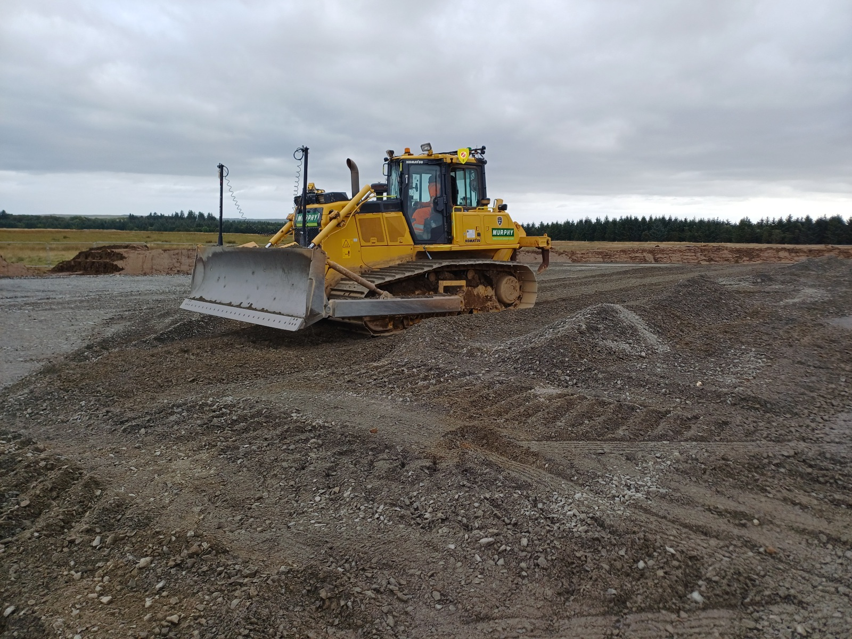
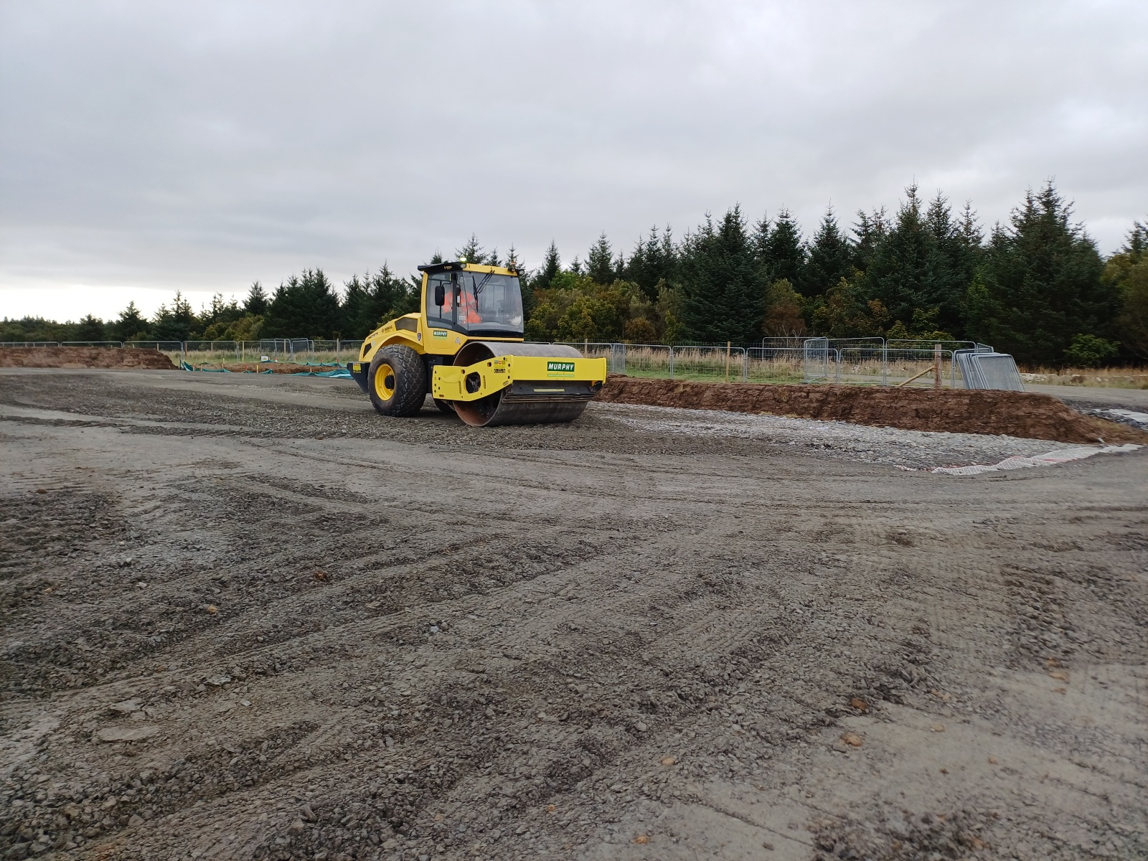
Project Update
90% of the Strainers/Posts and 20% of the mesh fencing has been completed on the boundary fencing, undertaken by local fencing contractors.
4000t of stone placed for the compound formation delivered from Gow's quarry.
Resistivity testing undertaken by Socotec, which was delayed due to the bird nesting season.
Topsoil stockpiled from work area and silt mitigation in place to mitigate water run-off.
Notes:
The Banniskirk Hub will design, build, test, commission, and hand over a 400kV substation in a phased approach to ensure a fully commissioned Hub in 2030.
The new AC substation will enable the connection of a proposed new 400kV overhead line (OHL) between Spittal and Loch Buidhe.
An extension to the existing Spittal 275kV/132kV Substation (under agreed permitted development) and a 275kV underground cables (UGC) connecting to the AC platform.
A DC cable connection to 2 GW bipole HVDC convertor station which will be co-located at the Banniskirk substation. The HVDC convertor station will provide the connection point for the consented Spittal to Peterhead 400kV subsea cable project.

Slide 11
Project Update
Update on Trial Blasting
Programme for trial blasting has not been confirmed and will be subject to providing the community with advance notification. Updates will be provided when available.
Preparation in each blasting area will consist of excavating down to rockhead to form a workface, allowing the blast material to fall. 30 holes will be drilled in each of two areas on the HVDC platform, approximately 300m from the A9 and 600m from Banniskirk House. Before blasting takes place, monitoring equipment will be installed at the noise/vibration sensitive properties.
Both blasts are expected to take place around lunchtime on the same selected day. Although mid-October is proposed, the exact date has not yet been confirmed. Access tracks and preparation of the blast sites remain incomplete, so a firm date cannot currently be provided. Details will be shared as soon as practicable, with at least seven days’ notice.
Notes:
The Banniskirk Hub will design, build, test, commission, and hand over a 400kV substation in a phased approach to ensure a fully commissioned Hub in 2030.
The new AC substation will enable the connection of a proposed new 400kV overhead line (OHL) between Spittal and Loch Buidhe.
An extension to the existing Spittal 275kV/132kV Substation (under agreed permitted development) and a 275kV underground cables (UGC) connecting to the AC platform.
A DC cable connection to 2 GW bipole HVDC convertor station which will be co-located at the Banniskirk substation. The HVDC convertor station will provide the connection point for the consented Spittal to Peterhead 400kV subsea cable project.

Slide 12
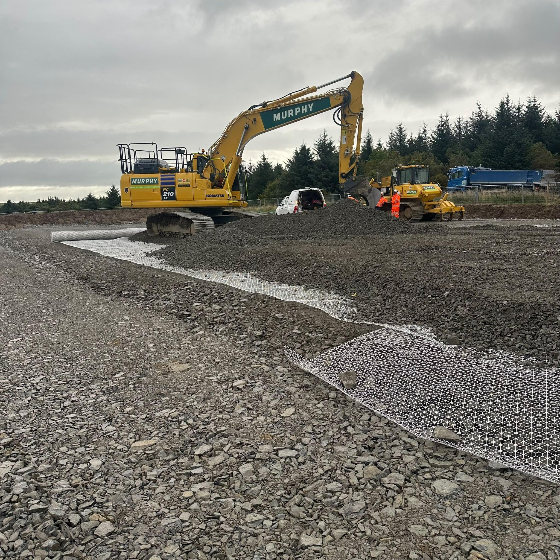
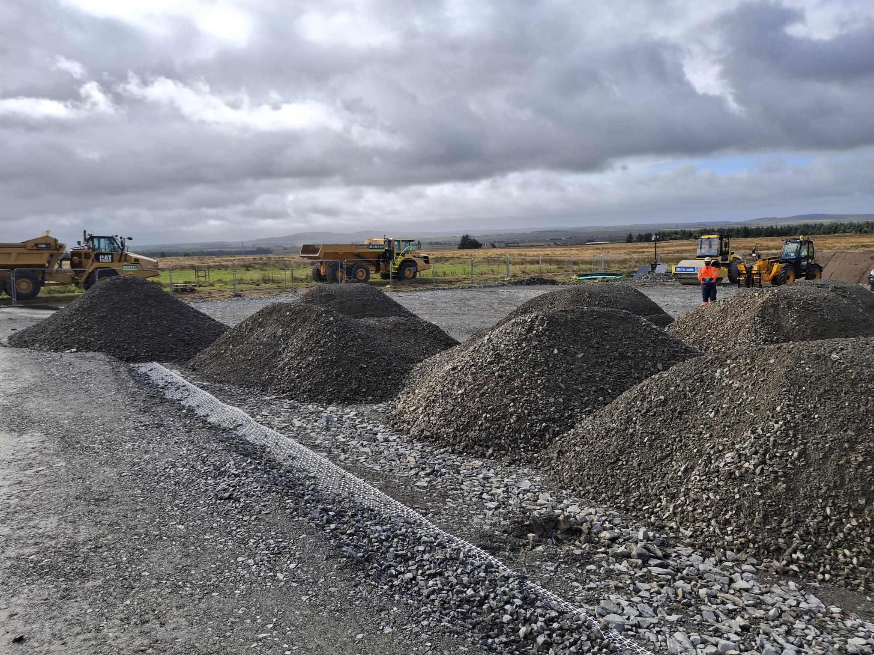
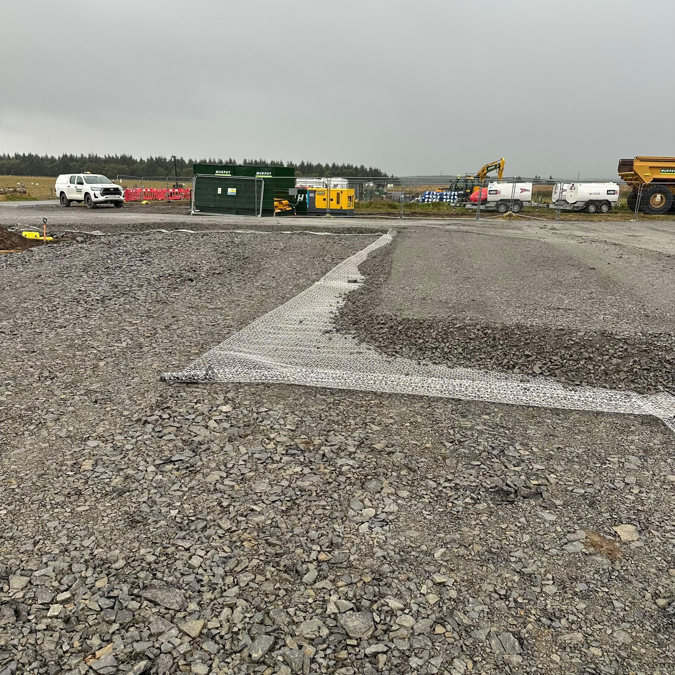
Four Month Look Ahead (Sept 26 - Jan 27)
The continuation of Permitted Development works as described previously.
Work with the Highland Council to ensure a timely Discharge of the planning conditions
On the discharge of the pre-commencement conditions we will start the Enabling Phase of the project.
Notes:
Continue to liaise closely with The Highland Council (THC) planning team through the discharge of conditions process.
Complete Archaeological Written Scheme of Investigation and programme of works. Plan and undertake works prior to commencement of Enabling Works.
Investigation works will continue across the project area including baseline water & noise monitoring, culvert investigations, Preliminary Ecological Appraisal survey undertaken in line with recommendations on nesting birds.
Contractors will continue to work on detailed designs and delivery models
Discuss with THC what, if any, works can be undertaken under permitted development (PD)

Slide 13
Community issues raised by residents
Roads and traffic
Traffic management arrangements at Georgemas and surrounding areas
Safety of school children getting to/from school bus pickup point
Use of single track road towards Halkirk
Litter picking activities – between Georgemas and Banniskirk
Water and drainage
Progress on flood risk and drainage assessments
Previously reported watercourse pollution concern and engagement with SEPA
Notes:
The Banniskirk Hub will design, build, test, commission, and hand over a 400kV substation in a phased approach to ensure a fully commissioned Hub in 2030.
The new AC substation will enable the connection of a proposed new 400kV overhead line (OHL) between Spittal and Loch Buidhe.
An extension to the existing Spittal 275kV/132kV Substation (under agreed permitted development) and a 275kV underground cables (UGC) connecting to the AC platform.
A DC cable connection to 2 GW bipole HVDC convertor station which will be co-located at the Banniskirk substation. The HVDC convertor station will provide the connection point for the consented Spittal to Peterhead 400kV subsea cable project.

Slide 14
Community issues raised by residents
Construction Impacts
Blasting
Dust suppression measures that can be implemented
UXO assessments at Banniskirk
Community
Defibrillator provision and community access arrangements
Compensation for locals living near new infrastructure
Notes:
The Banniskirk Hub will design, build, test, commission, and hand over a 400kV substation in a phased approach to ensure a fully commissioned Hub in 2030.
The new AC substation will enable the connection of a proposed new 400kV overhead line (OHL) between Spittal and Loch Buidhe.
An extension to the existing Spittal 275kV/132kV Substation (under agreed permitted development) and a 275kV underground cables (UGC) connecting to the AC platform.
A DC cable connection to 2 GW bipole HVDC convertor station which will be co-located at the Banniskirk substation. The HVDC convertor station will provide the connection point for the consented Spittal to Peterhead 400kV subsea cable project.

Slide 15
Community Council matters
Proposed process for notifying residents and stakeholders in advance of blasting including timescales and communication channels
Update of attendance allowance for CLG members
Notes:
The Banniskirk Hub will design, build, test, commission, and hand over a 400kV substation in a phased approach to ensure a fully commissioned Hub in 2030.
The new AC substation will enable the connection of a proposed new 400kV overhead line (OHL) between Spittal and Loch Buidhe.
An extension to the existing Spittal 275kV/132kV Substation (under agreed permitted development) and a 275kV underground cables (UGC) connecting to the AC platform.
A DC cable connection to 2 GW bipole HVDC convertor station which will be co-located at the Banniskirk substation. The HVDC convertor station will provide the connection point for the consented Spittal to Peterhead 400kV subsea cable project.

Slide 16
Any Other Business

Slide 17
Date of next meeting
Date of next meeting
  Suggested Wednesday 25 November or 02 December

